Slide 1
Natural Language Processing (NLP)
Lecture 15: Evaluating Document Groupings
Dr. Muhammad Taimoor Khan

Slide 2
How can we tell the right number of clusters?
In general, this is a unsolved problem. However there are many approximate methods. In the next few slides we will see an example.
10
9
For our example, we will use the familiar katydid/grasshopper dataset.
However, in this case we are imagining that we do NOT know the class labels. We are only clustering on the X and Y axis values.
8
7
6
5
4
3
2
1
1
2
3
4
5
6
7
8
9
10

Slide 3
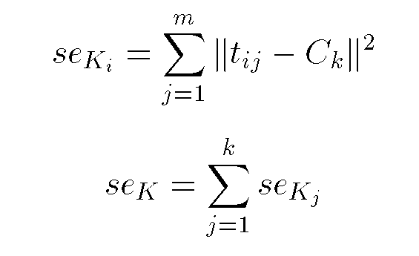
Squared Error
10
9
8
7
6
5
4
3
2
1
1
2
3
4
5
6
7
8
9
10
Objective Function

Slide 4
When k = 1, the objective function is 873.0
1
2
3
4
5
6
7
8
9
10

Slide 5
When k = 2, the objective function is 173.1
1
2
3
4
5
6
7
8
9
10

Slide 6
When k = 3, the objective function is 133.6
1
2
3
4
5
6
7
8
9
10

Slide 7
We can plot the objective function values for k equals 1 to 6…
The abrupt change at k = 2, is highly suggestive of two clusters in the data. This technique for determining the number of clusters is known as “knee finding” or “elbow finding”.
1.00E+03
9.00E+02
8.00E+02
7.00E+02
6.00E+02
Objective Function
5.00E+02
4.00E+02
3.00E+02
2.00E+02
1.00E+02
0.00E+00
k
1
2
3
4
5
6
Note that the results are not always as clear cut as in this toy example

Slide 8
Clustering Evaluation Techniques

Slide 9
Clustering Evaluation
Compactness among the members of the same clusters
Small variance among members of the same cluster
High variance (separation) among members of different clusters
Types of evaluation techniques
Internal evaluation techniques (evaluate from within the given data)
External evaluation techniques (evaluate in reference to an external reference)

Slide 10
1. Squared Error
Internal evaluation scheme
10
9
8
7
6
5
4
3
2
1
1
2
3
4
5
6
7
8
9
10
Objective Function

Slide 11

2. Davies Boulden Index
An internal evaluation scheme
Given N dimensional points, let C_{j} be a cluster of data points. Let X_{j} be an N-dimensional feature vector assigned to cluster C_{j}
$$s_{i}={\left(\frac{1}{T_{i}}\sum_{j=1}^{T_{i}}{{|X_{j}−A_{i}|}^{p}}\right)}^{\frac{1}{p}}$$
Here, A_{i} is the centroid of Cluster C_{i}
T_{i} is the size of cluster C_{i}
S_{i} the measure of scatter in Cluster C_{i}
X_{j} is the j^{th} data point in C_{i} & P is constant usually 2
Expensive for high dimensional data!

Slide 12
Modification
$$M_{ij}={||A_{i}−A_{j}||}_{p}={\left(\sum_{k=1}^{N}{{|a_{k,i}−a_{k,j}|}^{p}}\right)}^{\frac{1}{p}}$$
Constant (usually 2)
Centroids
K^{th} dimension of the two centroids

Slide 13

3. Dunn Index
Internal evaluation scheme
Let C_{i} be a centroid (cluster) vector. Let x and y be two objects belonging to C_{i}, then
$$∆_{i}=\max_{x,y∈C_{i}}d(x,y)$$
d is the distance between two farthest objects in a cluster
$$∆_{i}=\frac{1}{|C_{i}|(\left|C_{i}\right|−1)}\sum_{x,y∈C_{i}}{d(x,y)}$$
Or
$$∆_{i}=\frac{\sum_{x∈C_{i}}{d(x,μ)}}{|C_{i}|}$$
Mean distance

Slide 14

4. Silhouette
Internal evaluation scheme
Measures how similar an object is to its own cluster (cohesion) compared to other clusters (separation)
Ranges [-1, 1], where higher value suggests better match
$$S\left(i\right)=\frac{b\left(i\right)−a(i)}{max⁡\{a\left(i\right), b(i)\}}$$
$$S\left(i\right)=\left\{\begin{matrix}1−\frac{a(i)}{b(i)} & ifa\left(i\right)<b(i) \\ 0 & ifa\left(i\right)=b(i) \\ \frac{b(i)}{a(i)}−1 & ifa\left(i\right)>b(i)\end{matrix}\right.$$
i – data point
a(i) – average distance of the data point i from all data points of the same cluster
b(i) – smallest average distance of i to all points in any other cluster of which i is not a member

Slide 15

External Evaluation Techniques
Gold standard – Produced by human judges with a good level of inter-judge agreement
Using set of classes as an evaluation bench mark or gold standard
$$Purity\left(∩,∁\right)=\frac{1}{N}\sum_{k}{\max_{j}}|w_{k}∩C_{j}|$$
$$∩=\left\{w_{1},w_{2}, …w_{k}\right\} clusters$$
$$∁=\left\{c_{1},c_{2},…,c_{j}\right\} classes$$
w_{k} is an item in cluster k and c_{j} is an item in class j

